Slide 1
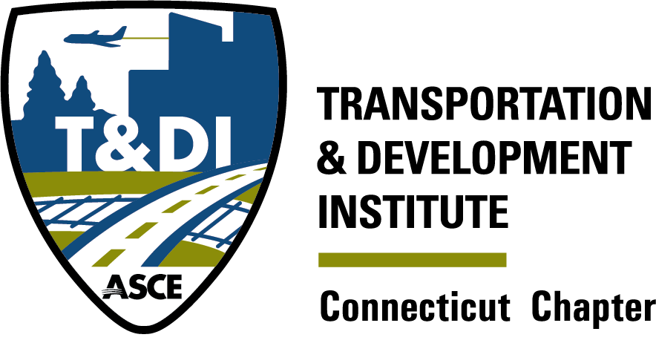
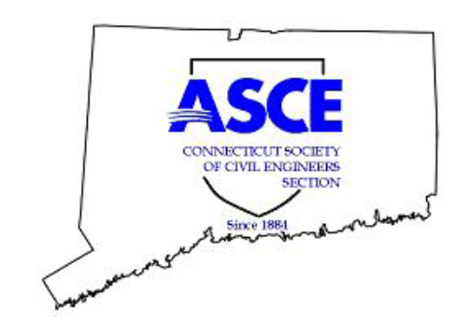
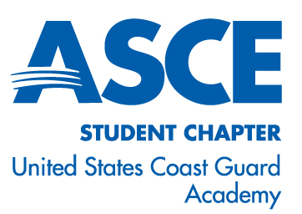

CSCE Dinner meeting
Qqqqq1` 1111111111111111111111111111111111111111
Co-Sponsored by the CT Chapter of the ASCE Transportation & Development Institute and the ASCE Student Chapter at the USCGA
Join ASCE as a Student for FREE on www.asce.org or scan this QR Code
Make friends. Advance your career. Shape the future. Get connected.
Join thousands of ASCE Members who are making a difference in the
civil engineering professional community while still in college. Student
Members participate in competitions, share resources, and offer lots
of educational and networking activities.
Latest Activities of the Connecticut Port Authority
Michael J. O’Connor
Executive Director of the Connecticut Port Authority
April 14, 2026

Slide 2
Tonight’s Schedule
5:30 – 6:30 p.m. Social Hour 6:30 – 7:00 p.m. Dinner 7:00 p.m. Opening remarks, USCGA Student presentation, Scholarships, Speaker Introduction 7:10 p.m. Presentation

Slide 3





Thank you to this year’s Annual Sponsors

Slide 4
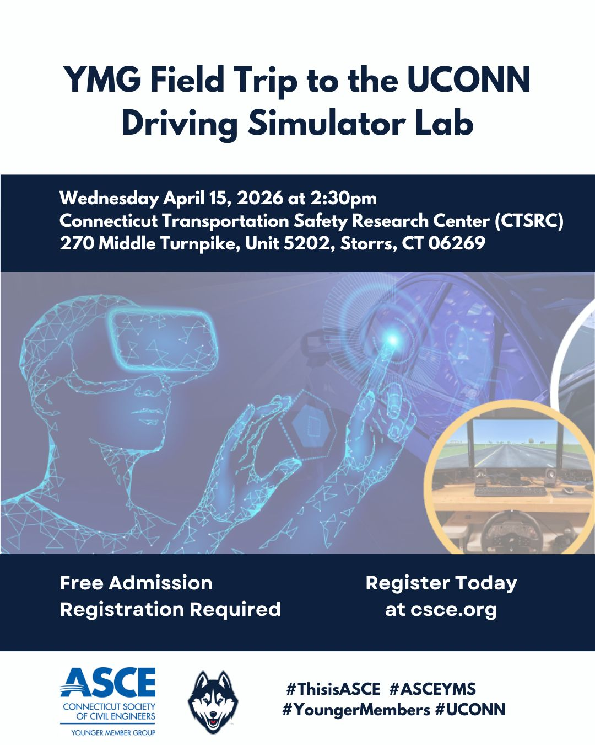
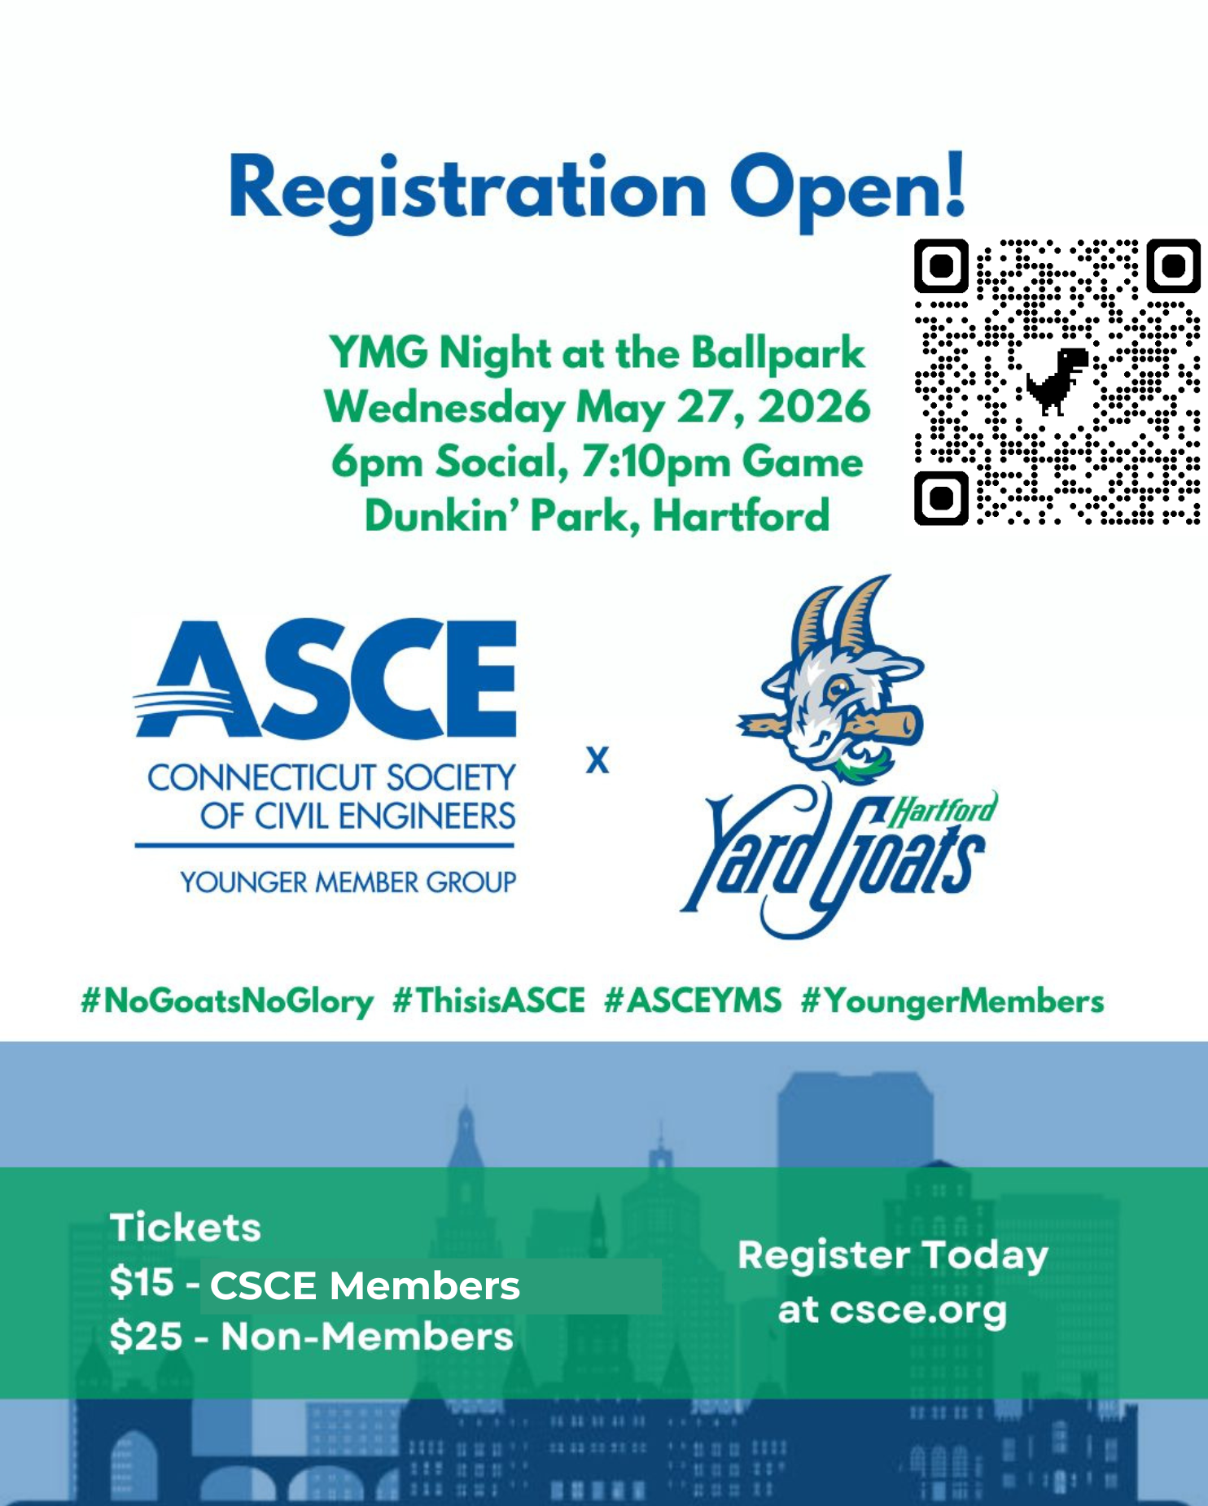


Slide 5
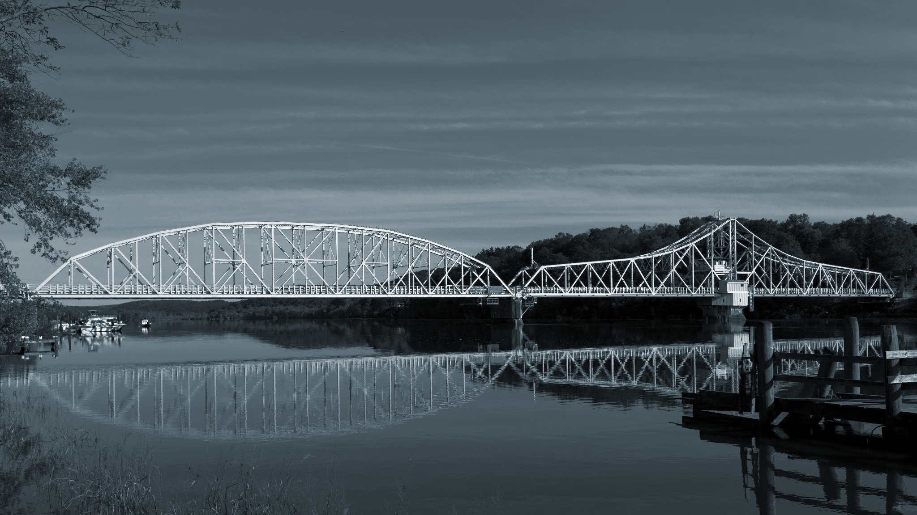
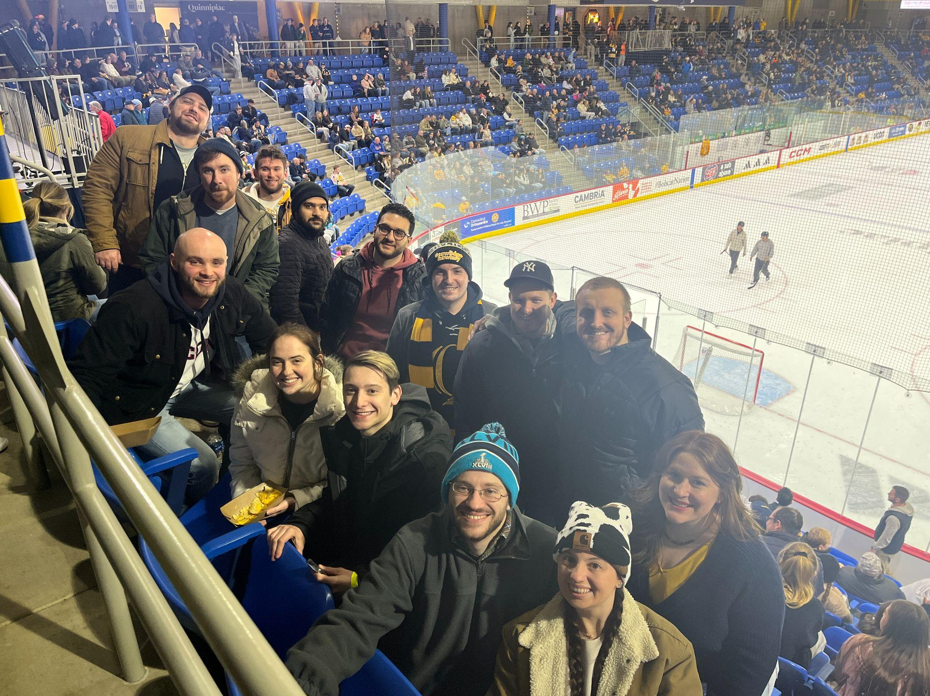
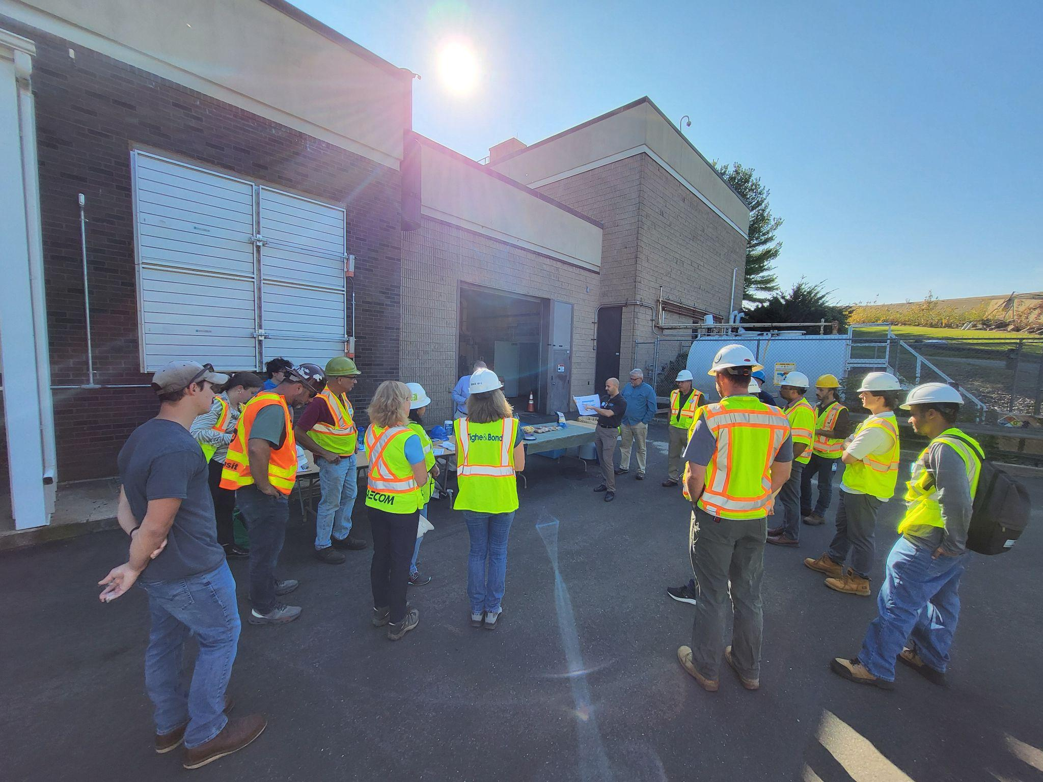
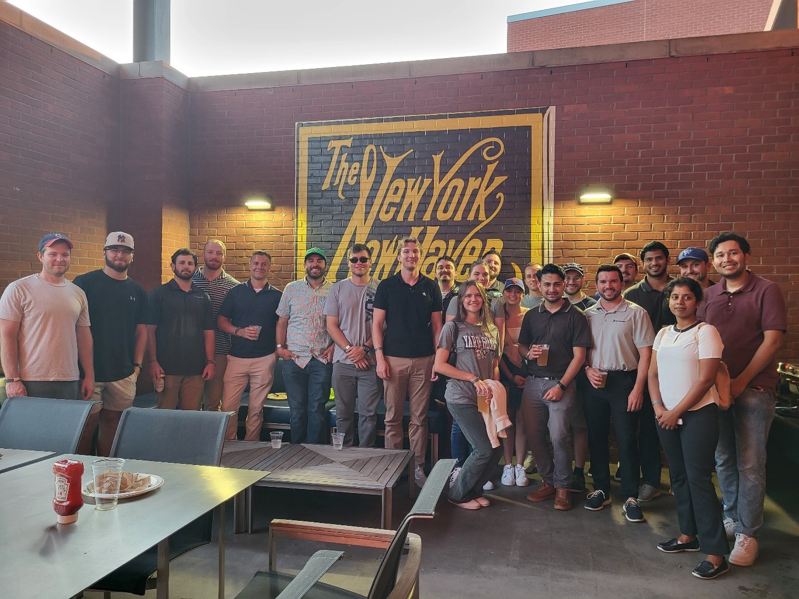
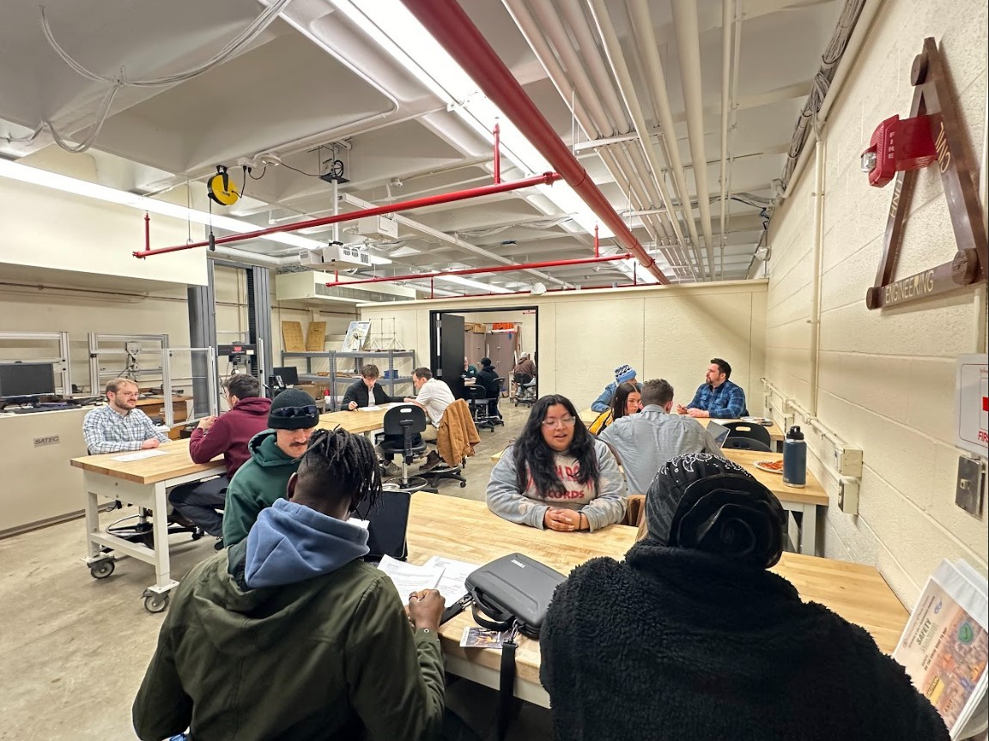
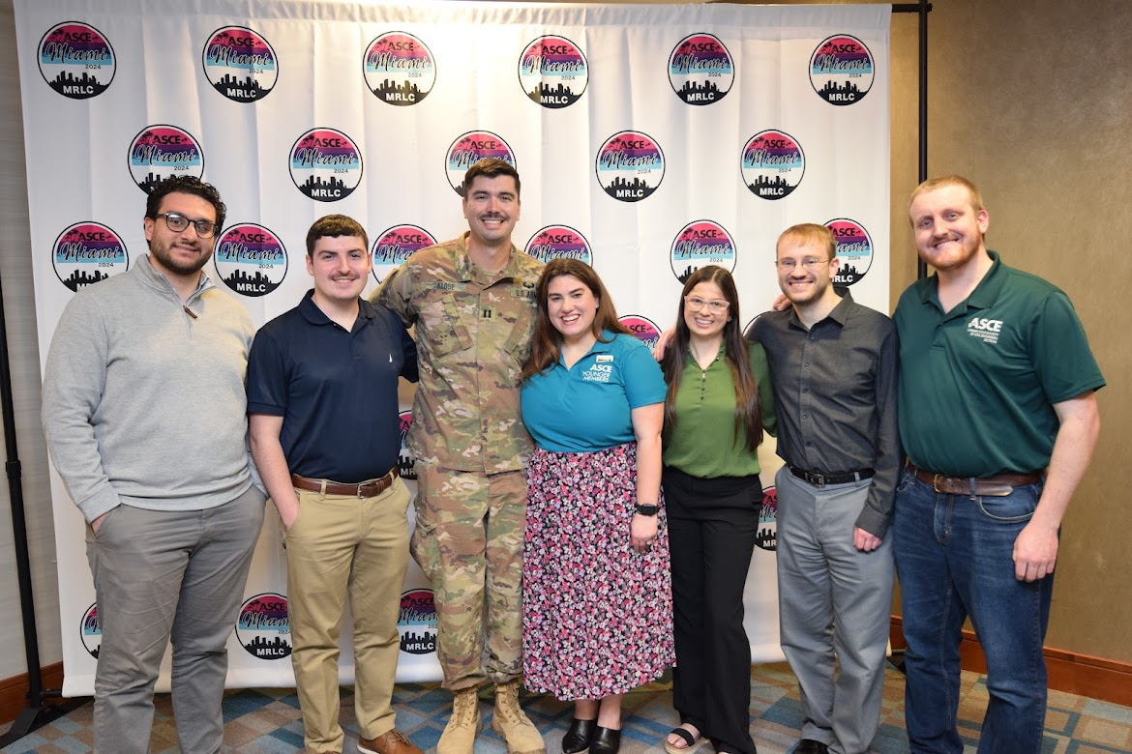
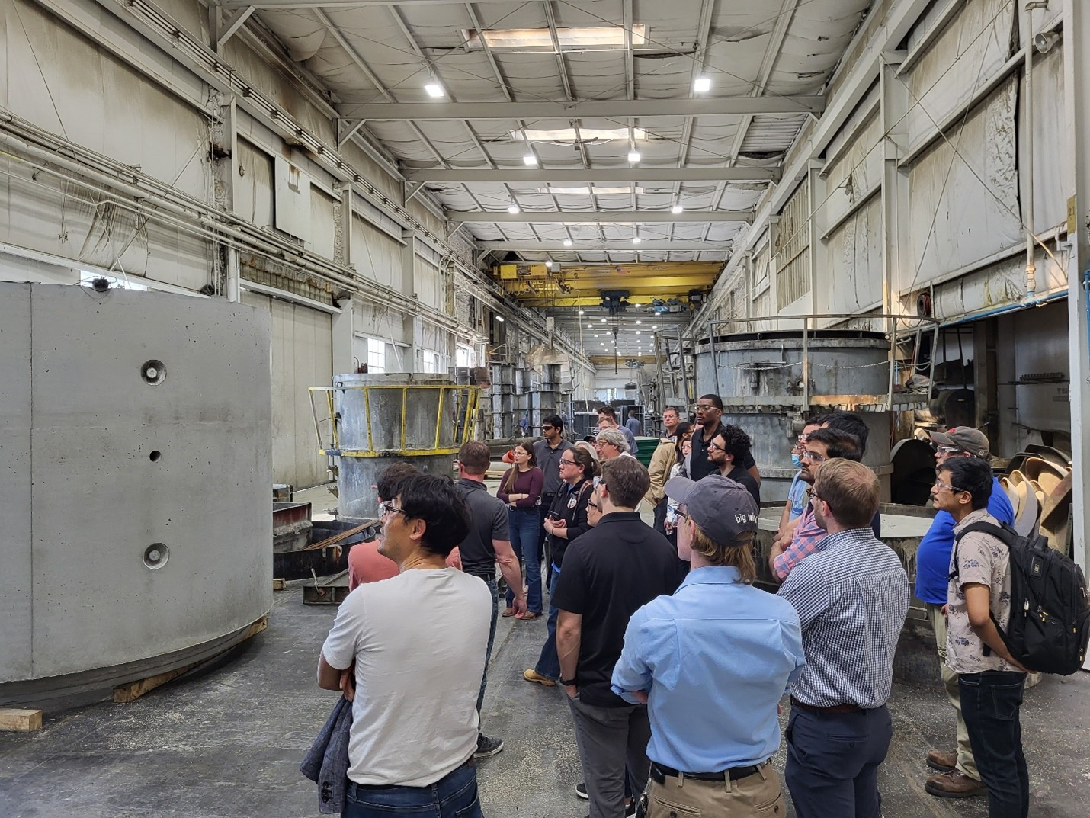
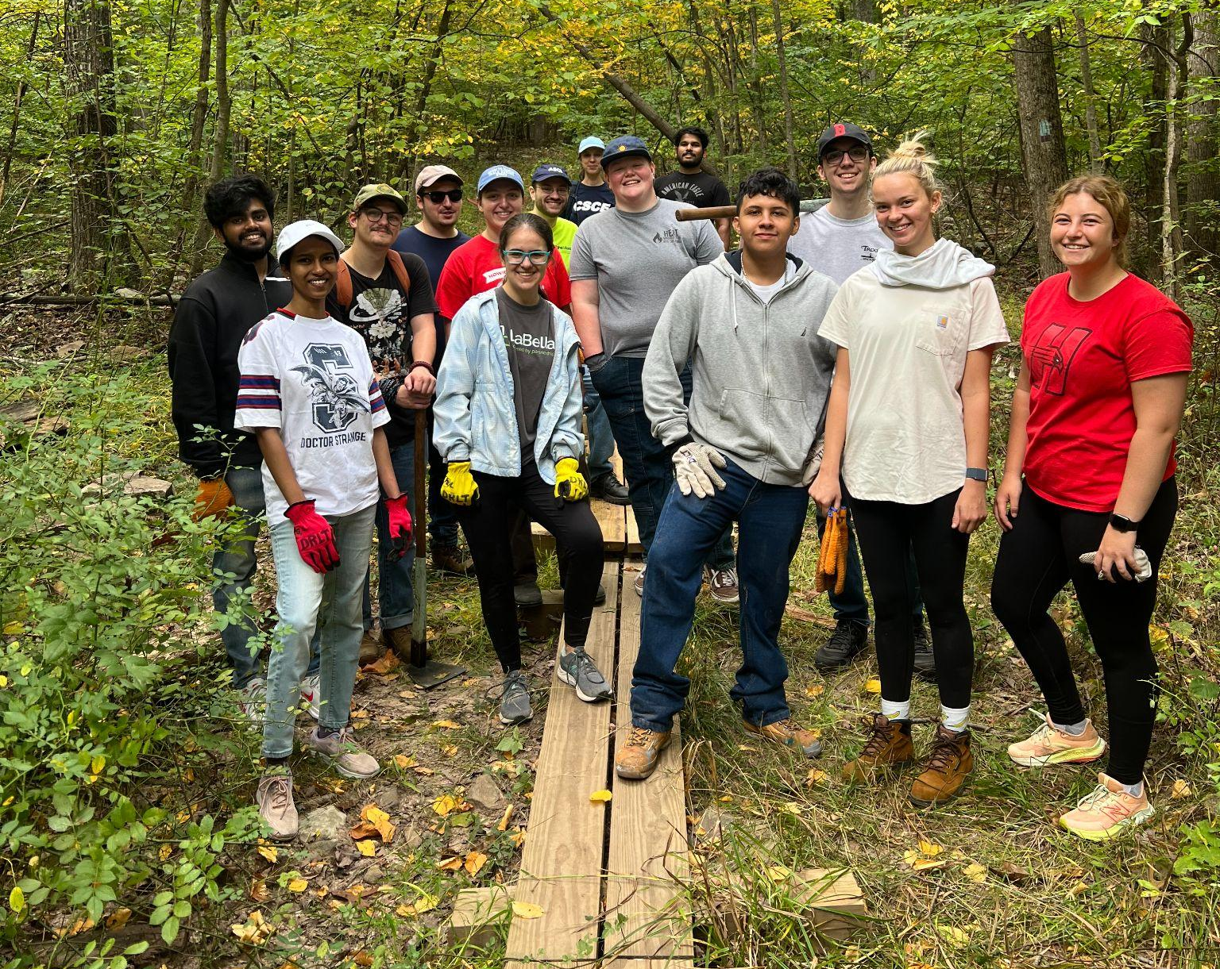
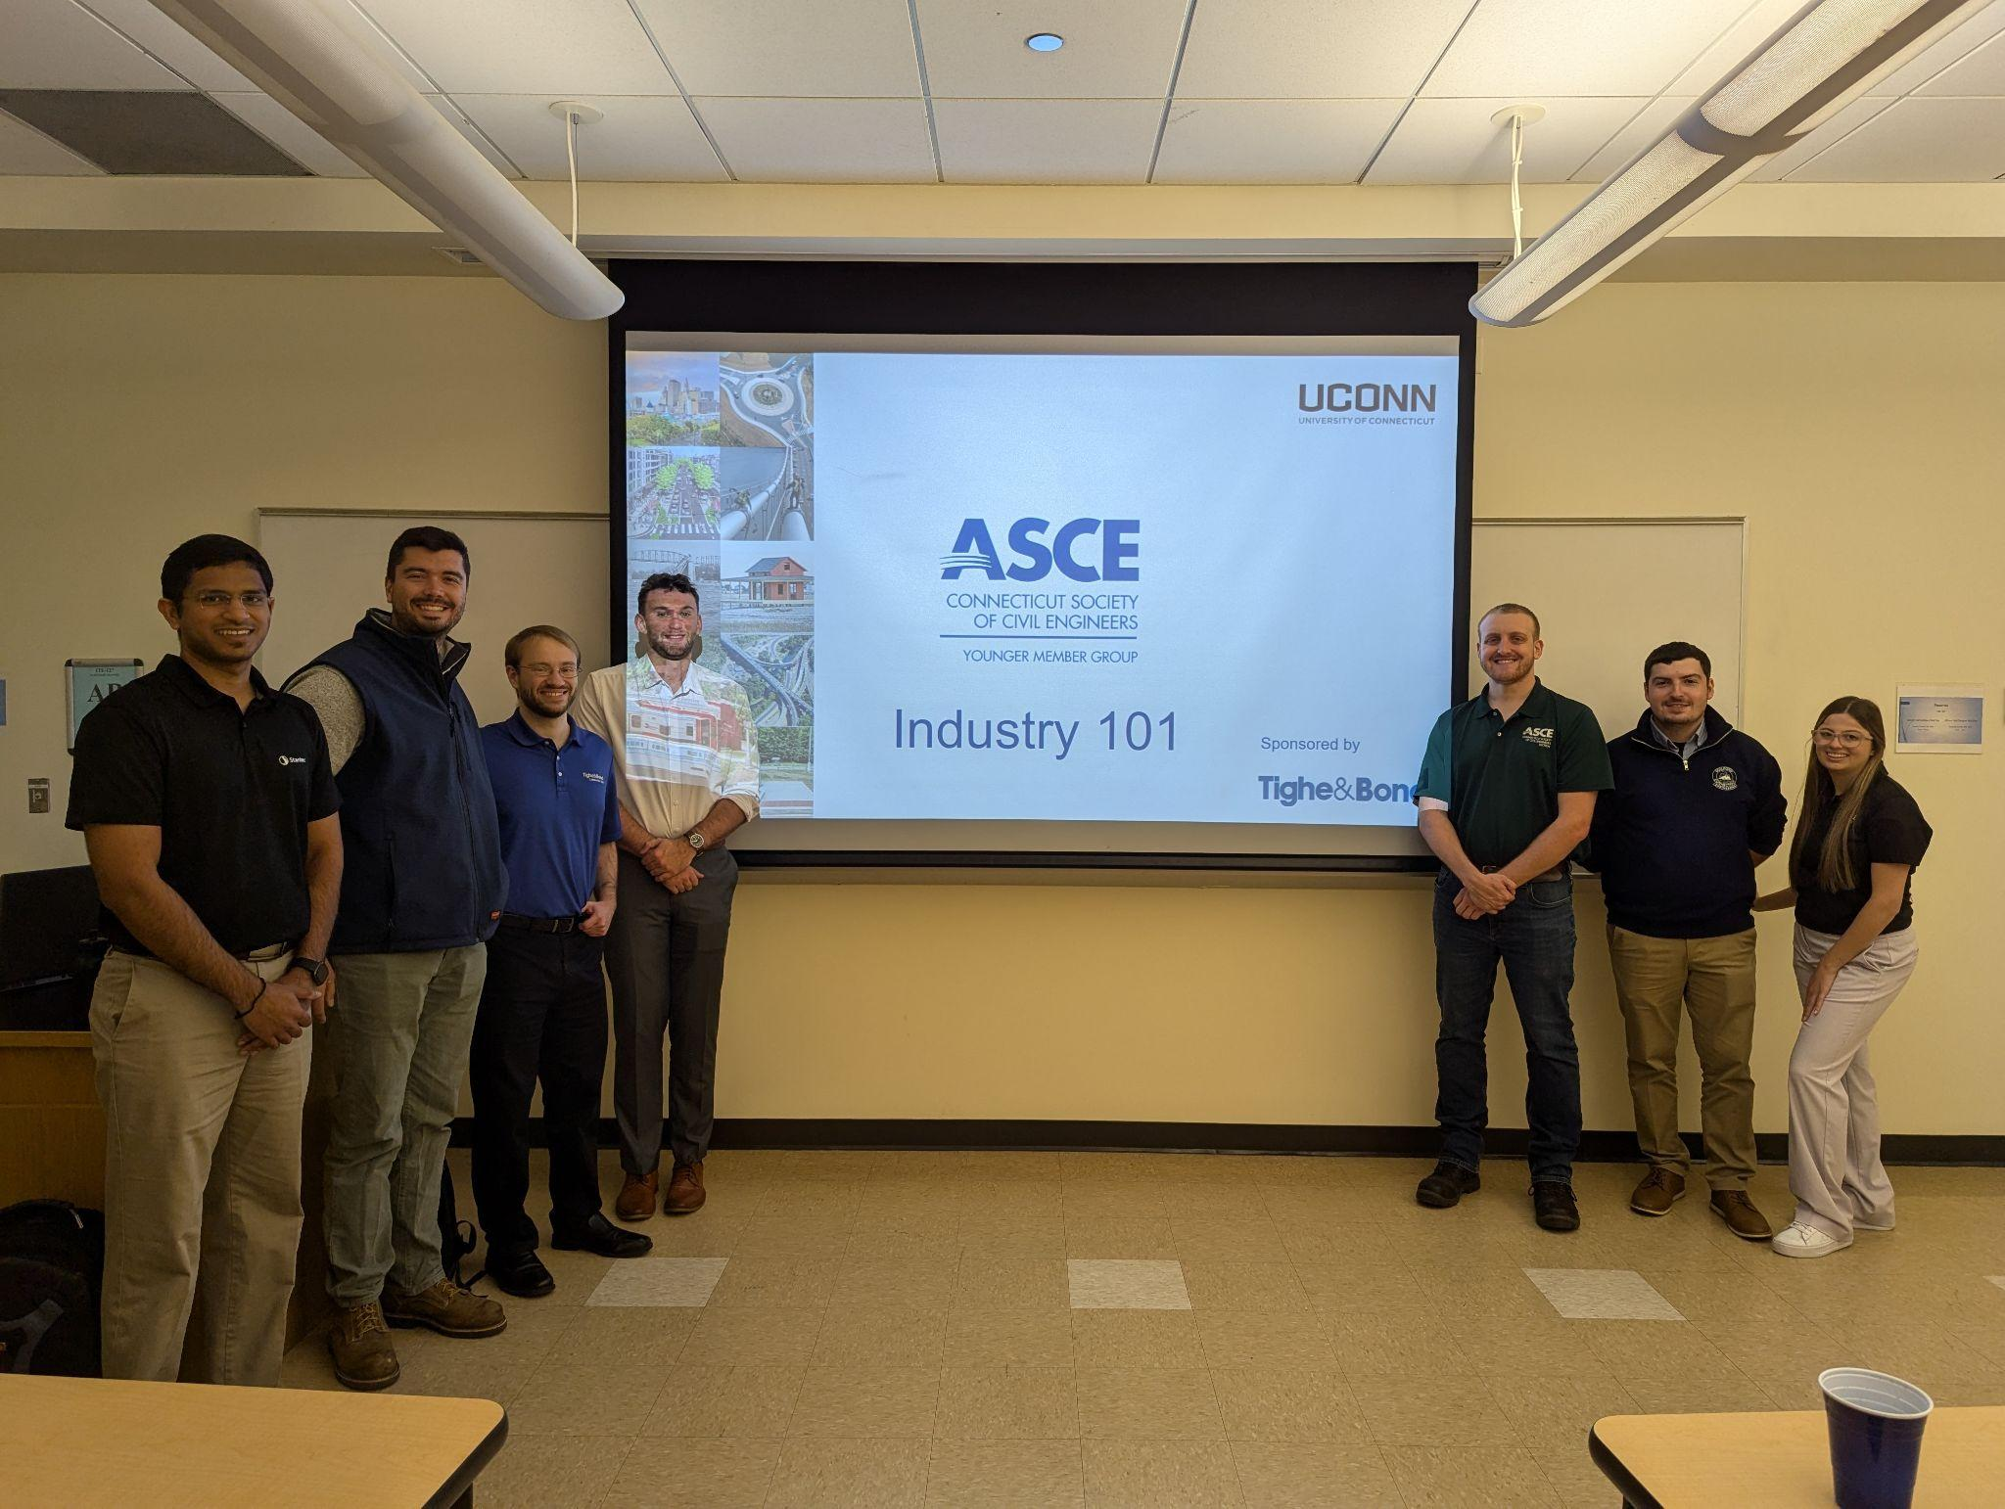
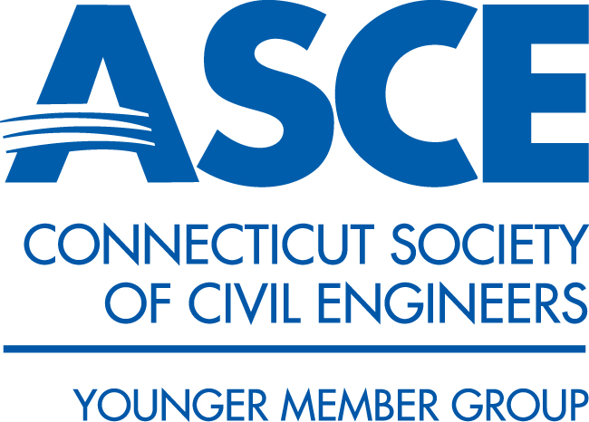




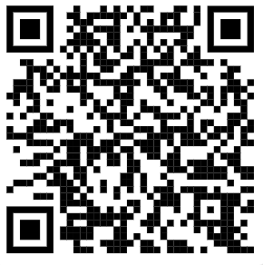
csceymg@gmail.com
asce.csce.ymg
CSCE Younger Members
CSCE Younger Members
EVENTS!
Networking - Volunteering - Sports Outings - Student Engagement - Site Visits - Conferences - and More!

Slide 6
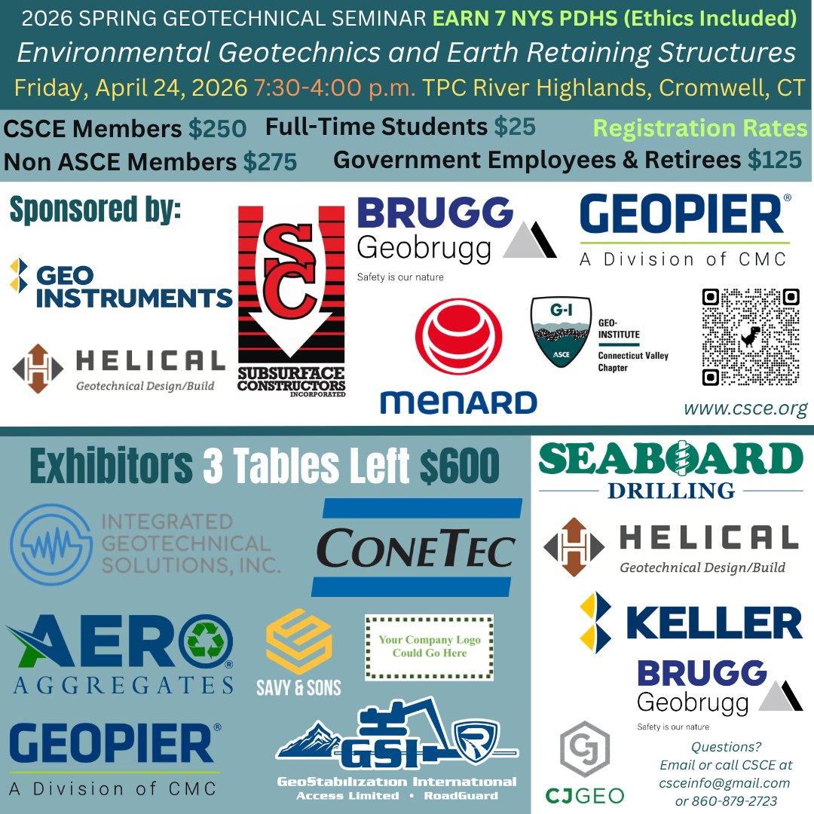

Slide 7
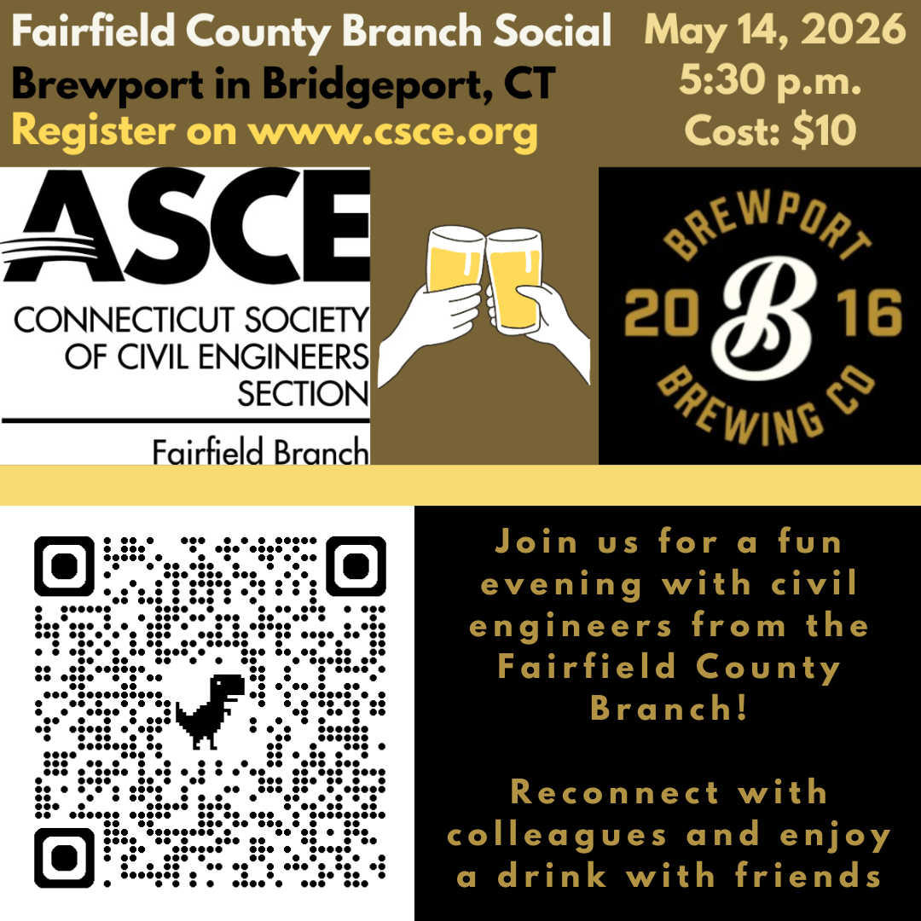

Slide 8
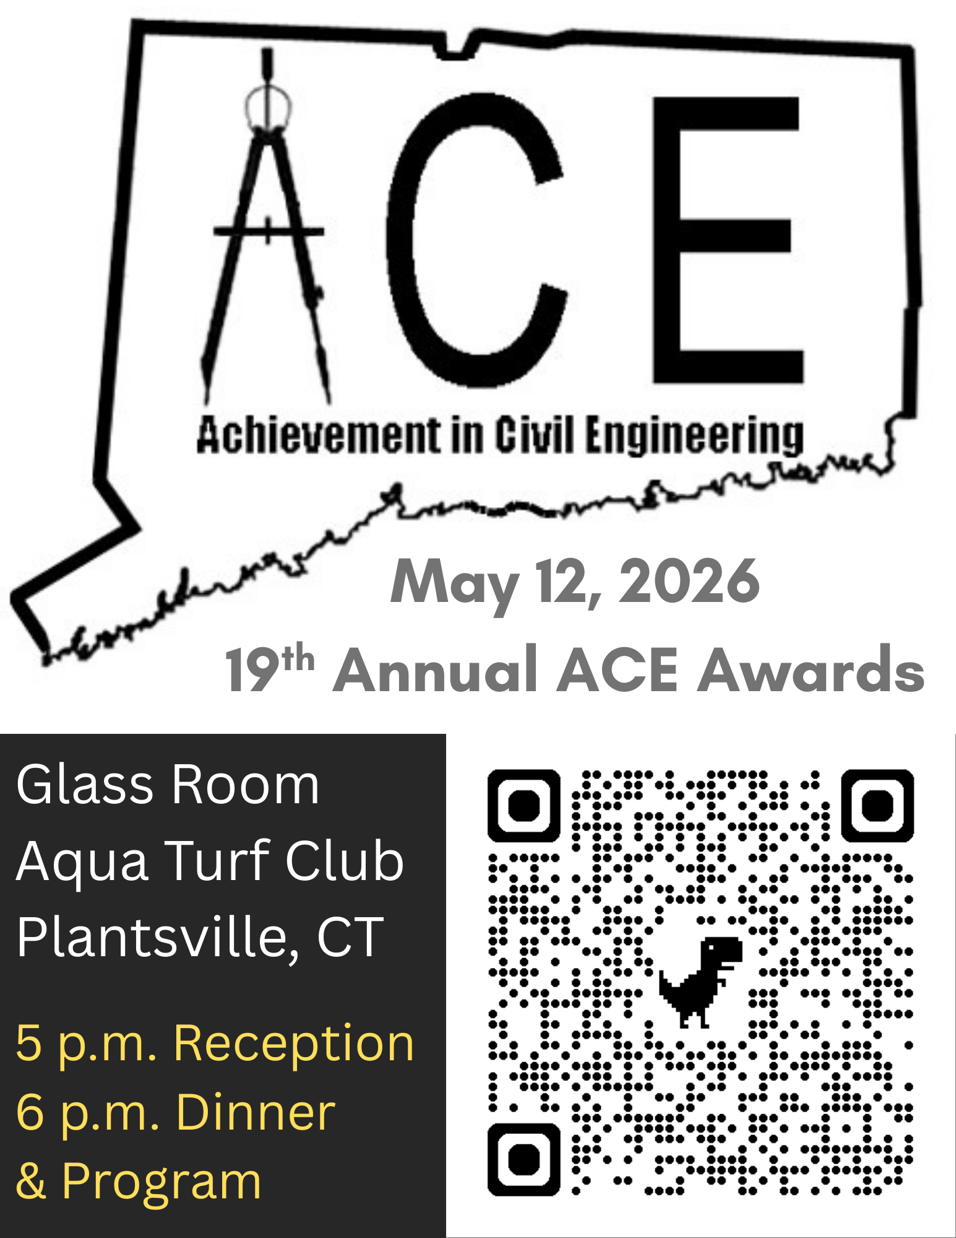

Slide 9
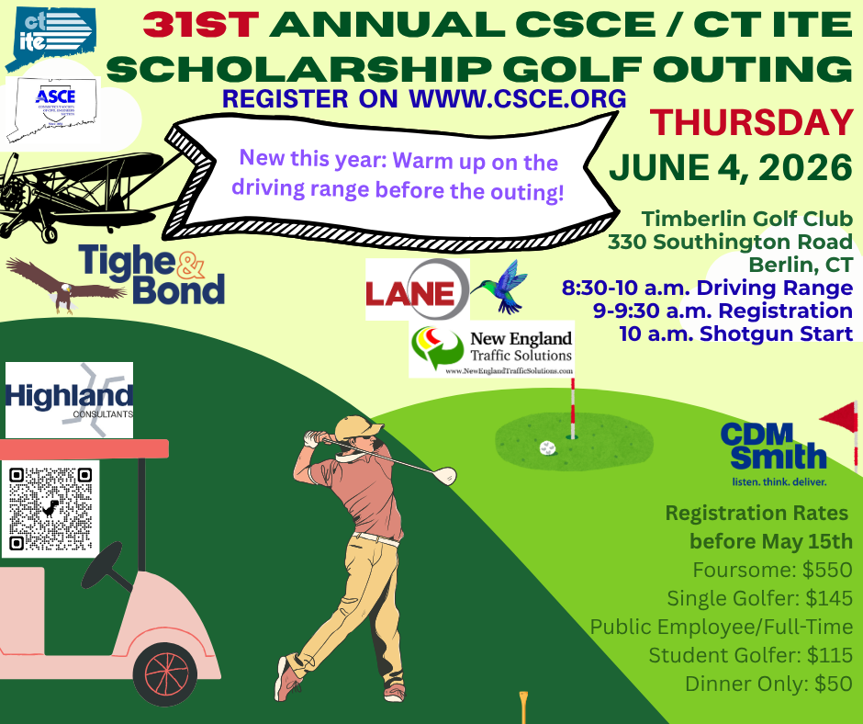

Slide 10
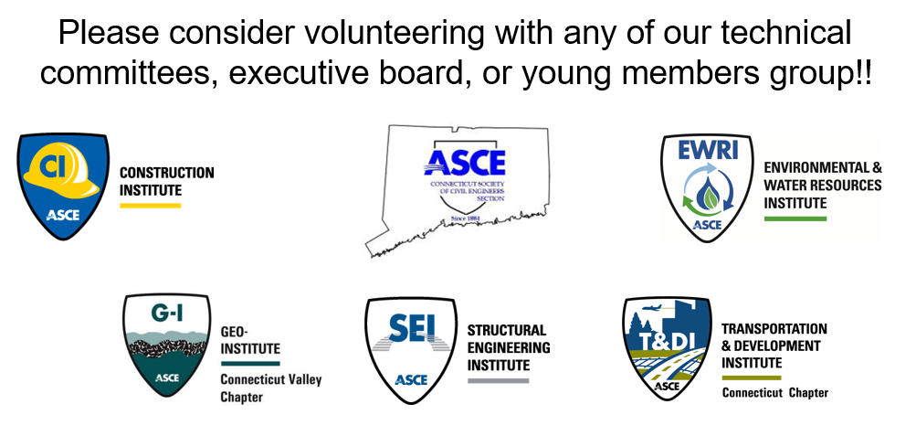
Get Involved in CSCE!

Slide 11
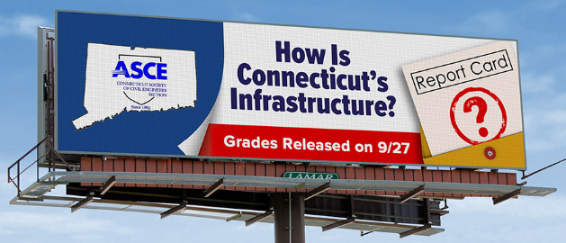
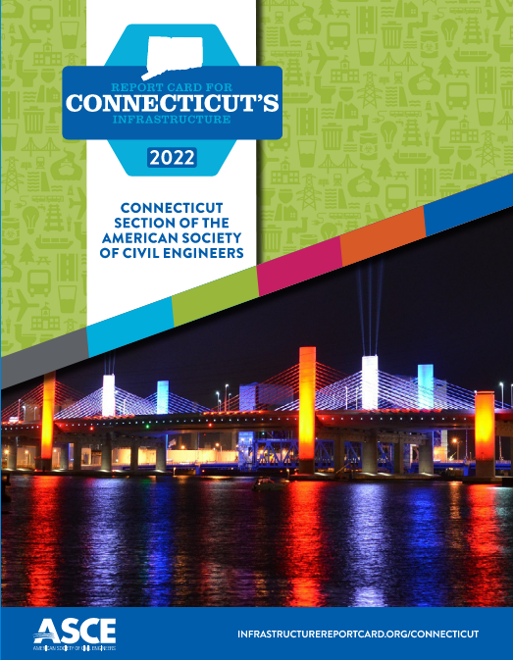

Request for Authors for 2026 Update to CT Infrastructure Report Card
CSCE is currently seeking authors for the following Report Card sections:
Aviation*
Bridges
Drinking Water
Energy*
Ports*
Rails
Roadway
Wastewater
* New Sections for CT

Slide 12
Upcoming Civil Engineering Visits to Schools by CSCE Volunteers
April 21 Classroom Visit at Ansonia High School
April 22 STEAM EXPO at Bethel High School
April 23 High School Career Fair Expo, Middletown, CT
May 13 Classroom Visit at Westbrook High School

Slide 13
Request for Practitioner Advisors for ASCE Student Chapters in CT
Practitioner Advisors are essential to the goal of introducing students to the profession and helping them develop professional autonomy. Every Student Chapter should have two Practitioner Advisors (PAs). PAs are members of ASCE who reside within convenient distance of the university, but who are not full-time faculty members of that, or any other university. Ideally, one of the Practitioner Advisors is a Younger Member of the Society (aged 35 or younger). The primary role of the Practitioner Advisor is to motivate, encourage, offer constructive criticism, compliment, question, and be an example of high-caliber professional performance.
The following schools in CT have ASCE Student Chapters:
Central Connecticut State University (CCSU) University of Connecticut
University of Hartford University of New Haven
Quinnipiac University U.S. Coast Guard Academy
CT State Community College at Three Rivers (coming soon)
If you would like to learn more about what it takes to be a Practitioner Advisor, please send an email to csceinfo@gmail.com

Slide 14

Benefits of ASCE Student Membership
ASCE offers membership to students for FREE. Its resources provide students with helpful career advice, networking opportunities, and more.
Online Resources like Career Connections & Career Paths, Mentor Match & Salary Report, AccessEngineering Instructional Videos, and digital editions of Civil Engineering magazine
In-Person Student Competitions & Symposia like Concrete Canoe & Steel Bridge Competitions
Networking, Employment & Volunteer Opportunities through its Student Chapters
To join ASCE and a state section of ASCE like CSCE, please visit www.asce.org or scan the QR Code above and click Join in the top right corner of the page.

Slide 15
Student Scholarships
21 Scholarship Awardees this year!
Two Categories: Incoming & Current Undergraduates
Incoming Undergraduates (present tonight)
Orville Ferguson Platt Technical High School
Drew Manaresi Hall High School
Oliver Rohrbasser Greens Farms Academy
Clarabelle Sutjito Ridgefield High School

Slide 16
Student Scholarships
Incoming Undergraduates (not present tonight)
Arran Cocozza Greenwich High School
Carson Cook Southington High School
Tyler Holcomb Bristol Eastern High School
John Radziewicz Middletown High School

Slide 17
Student Scholarships
Current
Undergraduates
Present
Tonight
Iraklis Pouka
CCSU
Autumn Raffone
University of Hartford
Benjamin Shatzel
University of Connecticut
Francesco Spinelli
University of New Haven
Matthew Woska
Quinnipiac University
Emilia Wypasek
University of New Haven
Caeden Babcock
U.S. Coast Guard Academy
Mollie Brinker
U.S. Coast Guard Academy
Michaela Capano
Quinnipiac University
Kathryn Laibrandt
CT State Community College
Three Rivers Campus
Monet Massey
CCSU

Slide 18
Student Scholarships
Current Undergraduates (not present tonight)
Jacob Fox CT State Community College
Three Rivers Campus
John Kelly University of Hartford

Slide 19
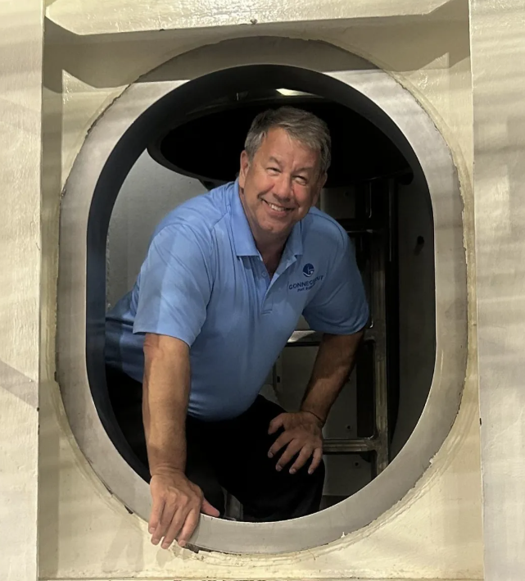
Meeting Presentation
Latest Activities of the Connecticut Port Authority
Michael J. O’Connor
Michael J. O’Connor, Executive Director of the Connecticut Port Authority, is a longtime Connecticut resident and Navy veteran, committed to growing the maritime economy on Connecticut’s coastline.
Prior to joining the Connecticut Port Authority, O’Connor completed a 32-year career in commercial nuclear power, most recently as the vice president at Dominion Energy’s Millstone Nuclear Power Station in Waterford, Connecticut. He has a bachelor’s degree in mechanical engineering from the University of New Haven and a master’s degree in business management from the University of Connecticut. O’Connor’s work in nuclear started in the United States Navy where he completed a 10-year enlistment and attained the rank of chief petty officer.
O’Connor is an elected member of the town of Bozrah’s Board of Finance and has been the chairman for 26 years. He is vice chair of the Mitchell College Board of Trustees and is a past member of the Southeastern Connecticut Water Authority.

